Slide 1

Used Cars Price Prediction:
By CHAVDA DIVYESH KETANKUMAR M.Sc. Artificial Intelligence & Machine Learning Five Year Integrated School of Emerging Science & Technology, Gujarat University, Navrangpura, Ahmedabad.

Slide 2
Outline:
Introduction
Problem Definition
Objectives
Dataset
Methodology
Project Workflow
Conclusion

Slide 3

Introduction:
The world is expanding daily, and with it, so are everyone's expectations.
One of them is going to purchase a car.
Used cars have become a popular mode of transportation for many people due to their affordability and practicality.
One of the most important factors that influence a buyer's decision is the price of the car.
However, a new person is unaware of the market value of their car.
Predicting the price of used cars accurately is a challenging task due to the complexity of the market and the numerous variables that affect the price.

Slide 4
Problem Definition:
The proposed research aims to develop a machine learning model that can accurately predict the prices of used cars by taking into account the various factors that influence the price.
The desire to purchase or sell a used car has attracted the attention of many people in the market at some point in their lives.
Overpaying or undervaluing car price, when you purchase or sell it, is a bad move.
This model will help used car buyers make informed decisions and provide a more transparent and efficient used car market.

Slide 5
Objectives:
To identify the most significant factors that affect the prices of used cars.
To build a statistical model that can forecast the price of a used car based on historical consumer data using Machine Learning algorithms.
To evaluate the performance of the developed model and compare it with existing models.
To provide a user-friendly interface for the model, allowing users to input relevant information and receive a price prediction.

Slide 6
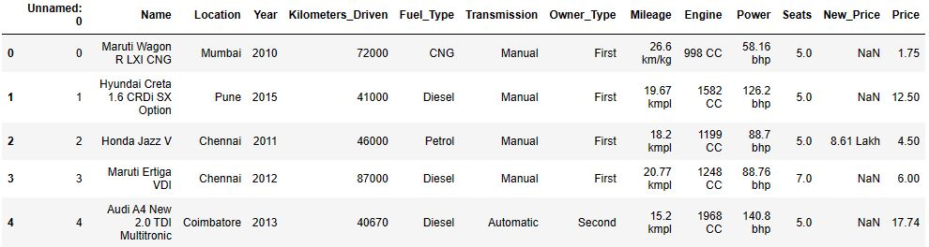
Dataset:
I took dataset from www.kaggle.com. And for prediction of price of used cars, our dataset looks like:
Dataset contains object & numerical values.
Dataset has 6019 records & 12 features.

Slide 7
Methodology:
Since this is a regression problem, I have implemented various Machine Learning algorithms like Linear Regression, Polynomial Regression, Random Forest Regressor and Decision Tree Regressor to build the model.
After implementing various algorithms, the model that provides the most accurate output will then be compared.

Slide 8
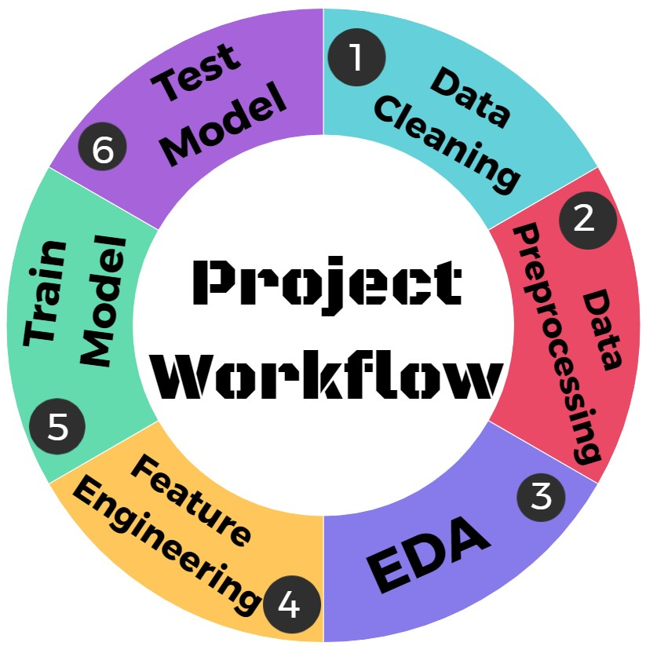
Project Workflow:

Slide 9
Project Workflow:
1. Data Cleaning:
Firstly, I dropped unnecessary columns ‘Unnamed: 0’ and ‘New Price’.
After that I have checked value counts of different features one by one.
I found that there are very few records having ‘Fuel type’ as ‘LPG’ and ‘Electric’ so that I dropped them.
In ‘Owner type’, the count of ‘Fourth & Above’ is just 9, which is very less so that I dropped them.
In ‘Seats’ & ‘Years’, I dropped that categories, where counts are very less.

Slide 10
Project Workflow:
2. Data Preprocessing:
After cleaning the data, stage of Preprocessing came.
I transformed data type of features, such as ‘Mileage’, ‘Engine’, ‘Power’ & ‘Seats’, to numeric.
Since, there are very much records of ‘Mileage’ and ‘Power’ where founded 0 (zero), I replaced that values by mean.
Since, there are very few records of ‘Engine’ and ‘Seats’ where founded null values, and also having more than one null value found for that record, I dropped that records.

Slide 11
Project Workflow:
3. Exploratory Data Analysis:
After preprocessing of data, stage of EDA came.
I did EDA for features one by one, I found that some features, such as ‘Kilometers Driven’, ‘Power’, ‘Engine’ and ‘Mileage’, having impact of outliers.
So, I removed outliers with the help of IQR method.
After with dataset which has not or very less impact of outliers, I did EDA again for all features.

Slide 12
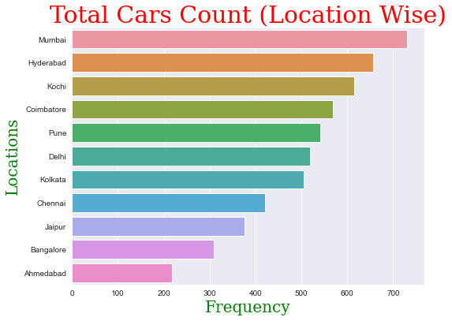
Project Workflow:
EDA for Location:

Slide 13
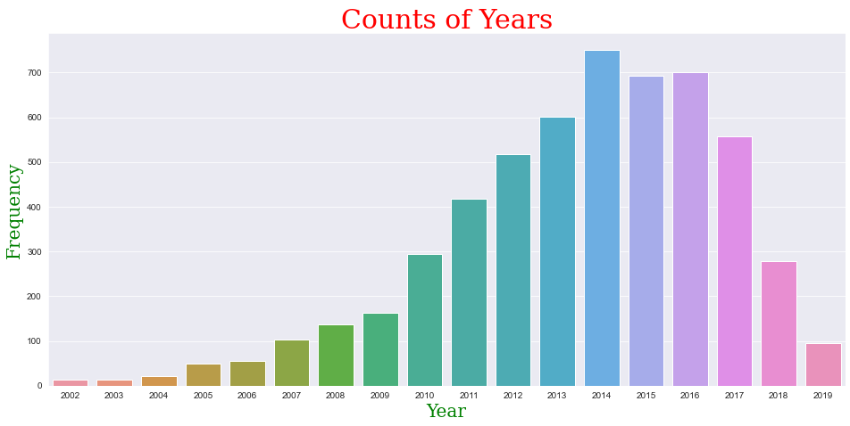
Project Workflow:
EDA for Year:

Slide 14
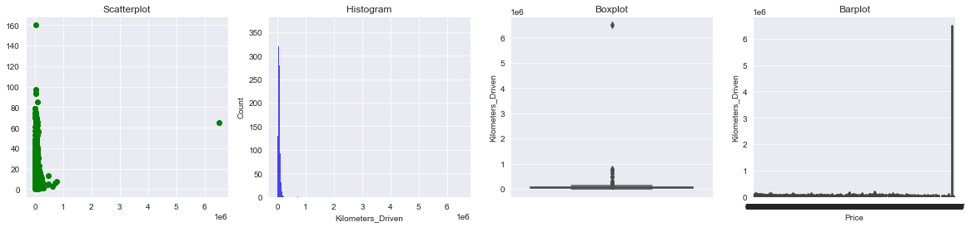
Project Workflow:
EDA for Kilometers driven, having impact of outliers:

Slide 15
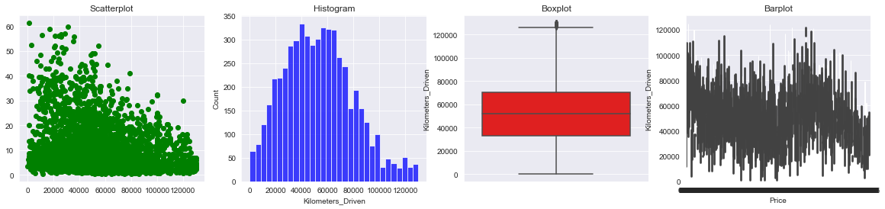
Project Workflow:
EDA for Kilometers driven, after removing outliers:

Slide 16
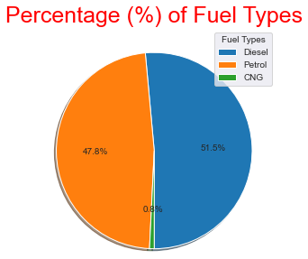
Project Workflow:
EDA for Fuel type:

Slide 17
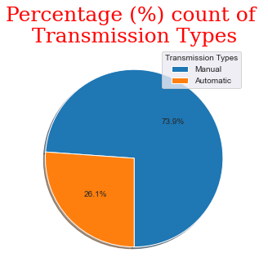
Project Workflow:
EDA for Transmission type:

Slide 18
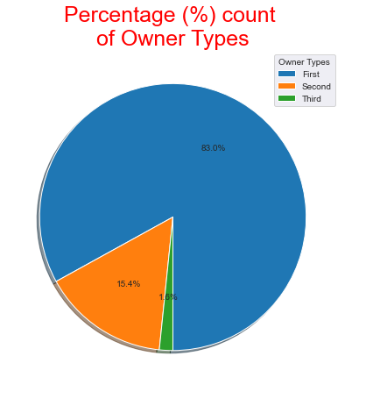
Project Workflow:
EDA for Owner type:

Slide 19
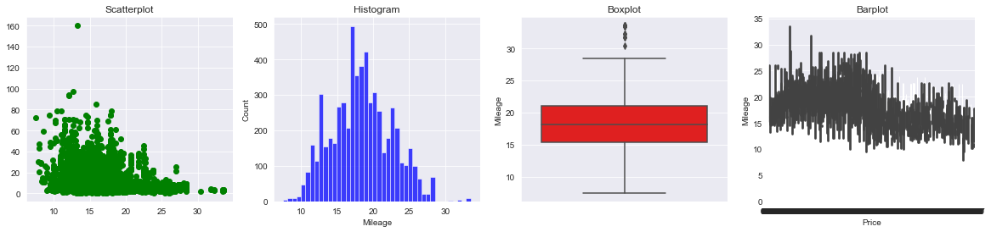
Project Workflow:
EDA for Mileage, having impact of outliers:

Slide 20
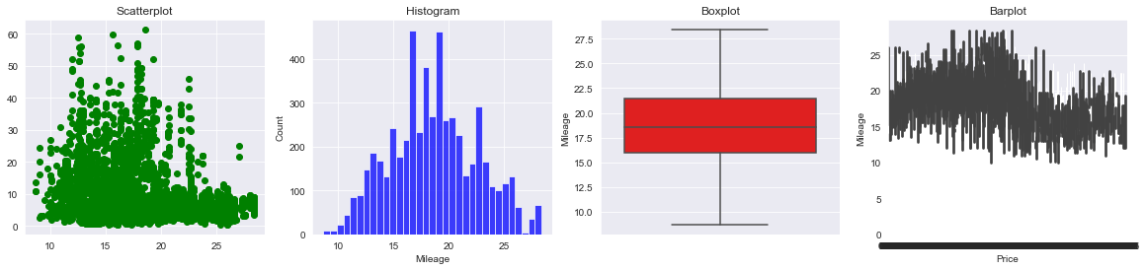
Project Workflow:
EDA for Mileage, after removing outliers:

Slide 21
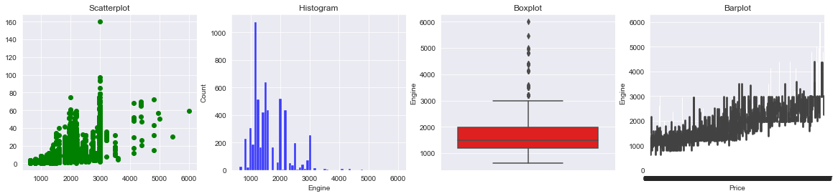
Project Workflow:
EDA for Engine, having impact of outliers:

Slide 22
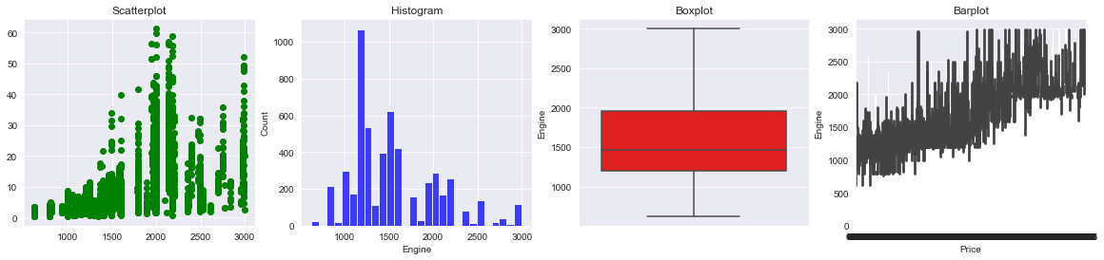
Project Workflow:
EDA for Engine, after removing outliers:

Slide 23
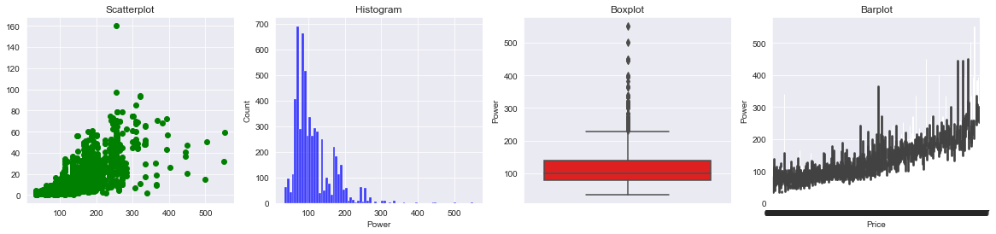
Project Workflow:
EDA for Power, having impact of outliers:

Slide 24
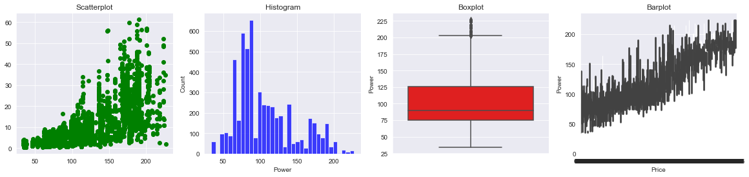
Project Workflow:
EDA for Power, after removing outliers:

Slide 25
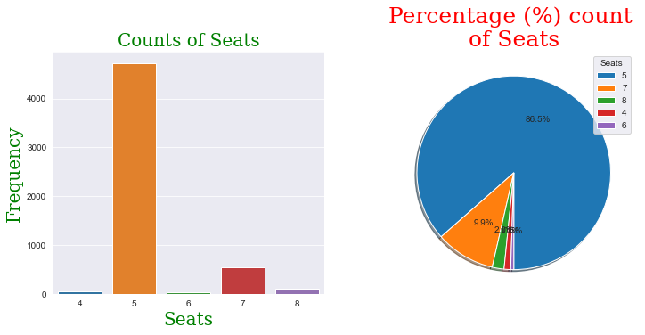
Project Workflow:
EDA for Seats:

Slide 26
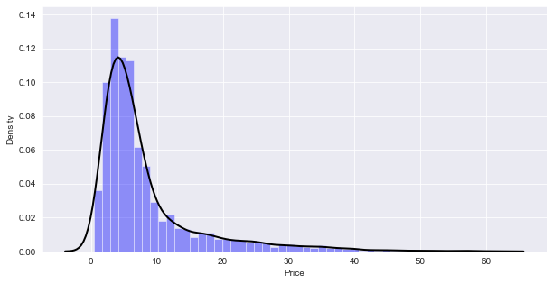
Project Workflow:
EDA for our target variable Price:

Slide 27
Project Workflow:
4. Feature Engineering:
After EDA, stage of Feature Engineering came.
I transformed the values of categorical features, namely ‘Location’, ‘Fuel Type’, ‘Transmission Type’ & ‘Owner Type’.
I assigned a new feature ‘No Year’ which is how old the car is in terms of years & drop the column ‘Year’.
At the end, I dropped ‘Name’ feature for train & test model with different Machine Learning algorithms.
After that, I checked for null values in dataset, found none.

Slide 28
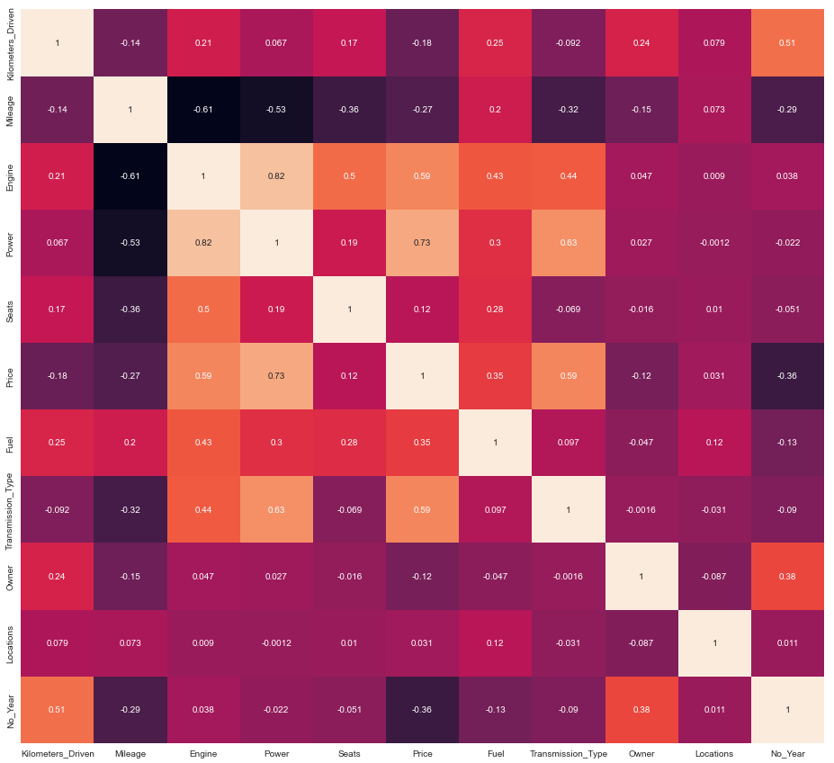
Project Workflow:
Thereafter I founded correlation between Independent variables & Dependent variable.

Slide 29
Project Workflow:
5. Train & Test Model:
After Feature Engineering, stage of Model Training & Testing came.
Before splitting the dataset into train and test data, I scaled the data with the help of Standard Scaler.
Thereafter, I split the dataset in 80:20 ratio to train and test model.
As mentioned before, I train and test model with Linear Regression, Polynomial Regression, Decision Tree Regressor & Random Forest Regressor.

Slide 30
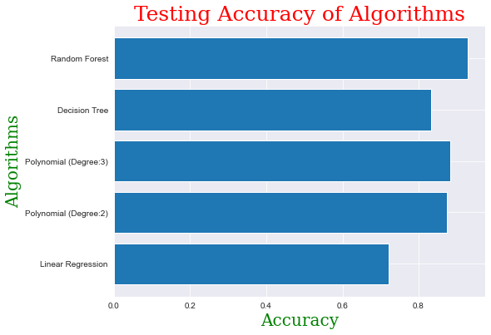
Project Workflow:
Comparing Testing accuracy of algorithms:

Slide 31
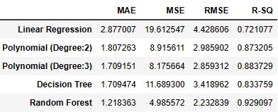
Project Workflow:
Mean Absolute Error, Mean Squared Error, Root Mean Squared Error & R² Score of different algorithms:

Slide 32
Conclusion:
On the dataset, I applied different Machine Learning algorithms to build the model for making prediction of car price.
It was found that the random forest algorithm provided the best accuracy compared to other algorithms.
Therefore, it can be concluded that the random forest algorithm is the most suitable for predicting car prices using this dataset.
This research provides a valuable contribution to the field of used car price prediction.
The developed model can be further improved.

Slide 33


Slide 34


